Slide 1

Banking and Financial Services
(Updated June 2025)
Disclaimer: The information presented in this lesson does not constitute legal, tax, investment, financial, or other advice. This lesson is intended as an informational resource to assist you in identifying or exploring resources and options for managing your personal financial situation.

Slide 2
Agenda
Financial Institutions
Banking Products and Services
Choosing a Financial Institution
Digital Banking
Smart Money Management
Banking and Financial Services

Slide 3
Activity: Banking Term Match-up
C
A. This account typically allows unlimited deposits but the institution may limit the number of transfers per month.
B. The ability to access your bank account, check account balances, transfer money, and pay bills virtually.
C. Using an app to access your bank account information via your smartphone.
D. A not-for-profit organization owned by its members.
E. When money is taken from a linked account and deposited into your checking account to cover a transaction amount larger than the balance.
F. Using a fake reader to capture account data stored in the magnetic strip of your banking cards.
G. Electronically transmitting a digital image of a check to your financial institution.
1.___ Mobile Banking
2.___ Overdraft Protection
3.___ Credit Union
4.___ Skimming
5.___ Remote Deposit Capture
6.___ Savings Account
7.___ Online Banking
E
D
F
G
A
B
Banking and Financial Services

Slide 4


Banks and Credit Unions
Banks
Credit Unions
For-profit institutions
Tend to be larger than credit unions and offer a wide variety of services
Generally charge higher interest rates on loans than credit unions and pay lower interest on deposit accounts
Not-for-profit institutions
Members are required to be a part of a specific group for eligibility
Tend to be smaller than banks and may not offer as many services as a result
Generally charge lower interest rates on loans than banks and pay higher interest on deposit accounts
Banking and Financial Services

Slide 5



Types of Accounts
Checking Accounts
Savings Accounts
No limit on monthly transactions
May require a minimum balance
May offer overdraft protection
Higher interest rates
Require minimum balance to earn interest and avoid maintenance fees
Easy access to funds
Banking and Financial Services

Slide 6
Products and Services
Deposit Products
Investment Products
Checking Accounts
Savings Accounts
Money Market Accounts
Certificates of Deposits (CDs)
Stocks
Bonds
Mutual Funds
Retirement Accounts
Lending Products
Other Products and Services
Auto Loans
Mortgage Loans
Personal Loans
Business Loans
Check Cards/Debit Cards
ATM Cards
Credit Cards
Safe Deposit Boxes
Banking and Financial Services

Slide 7

Factors to Consider when Selecting a Financial Institution
Convenience
Online and Mobile Banking Services
Fees and Account Requirements
Credit and Investments
Security
Customer Service Support
Compatibility
Banking and Financial Services

Slide 8

Actions to Resolve Complaints
Customer service representative
Branch manager
Institution president
Consumer Financial Protection Bureau (CFPB)
Installation legal office
Banking and Financial Services

Slide 9


Types of Digital Banking Platforms
Online Banking
Conduct banking transactions over the internet
Personal computer, laptop, or tablet
Mobile Banking Apps
Perform transactions through your handheld device
Smartphones and tablets
Peer-to-peer payment apps
Banking and Financial Services

Slide 10
Transactional Accounts
Transactional Accounts
A checking or shared draft account
Deposits
Funds Availability
Withdrawals and Transfers
Take money to the bank, use an ATM, or direct deposit
Cash and electronic deposits available the same day
Check deposits vary
Checks, ATM, debit card, electronic transfers
Banking and Financial Services

Slide 11

Smart Money Management
Maintain a spreadsheet or online tracker
Record all transactions
Keep receipts and verify transactions
Banking and Financial Services

Slide 12

Consequences of Mismanagement
Overdraft fees
  Spending more money than you have in your account
Missing errors
  Can affect account balance and might cause overdrawing from account
Drop in credit score
  Difficult to get loans or credit cards
Risk of fraud or identity theft
  Could miss early warning signs and have to manage bigger issue later
Military-related consequences
  Potential disciplinary action, loss of orders, loss of security clearance
Banking and Financial Services

Slide 13
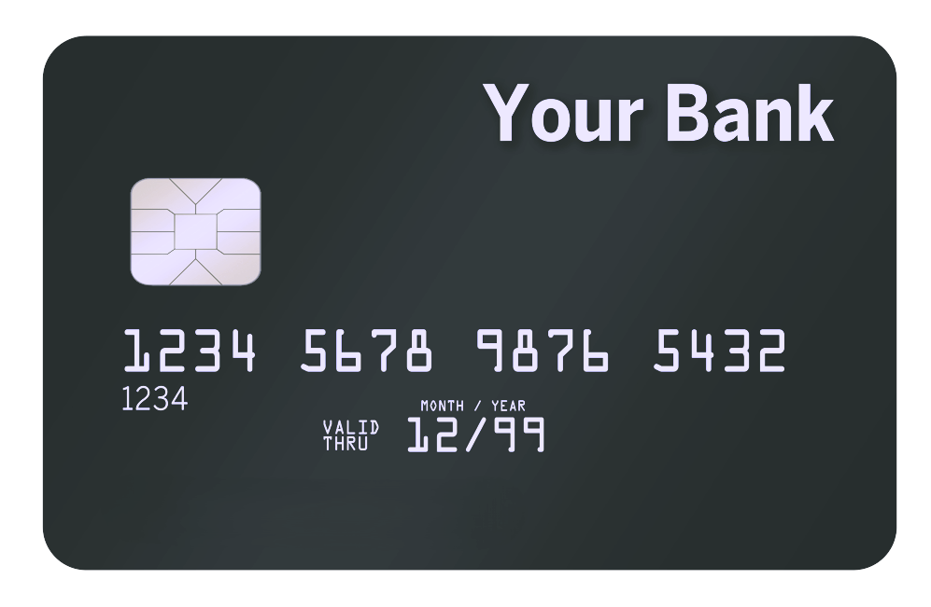

Activity – Consequences of Financial Mismanagement
John Smith is an E-3. He consistently overdrafts his checking account and recently had his debit card declined when trying to make a purchase.
Banking and Financial Services

Slide 14

Additional Support and Assistance
Available Resources
  Personal Financial Managers, Personal Financial Counselors, or Financial Readiness Program Specialists at your local military and family support center
  Command/Unit Financial Specialist (USN, USMC, USCG)
  Installation legal office
  Military aid and relief societies
Banking and Financial Services

Slide 15
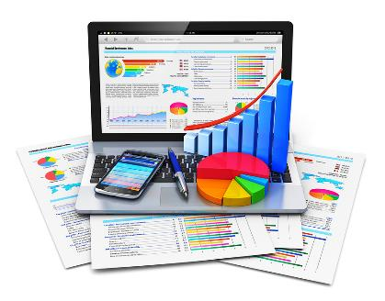
Conclusion
Financial Institutions
Banking Products and Services
Choosing a Financial Institution
Digital Banking
Smart Money Management
Banking and Financial Services

